Slide 1




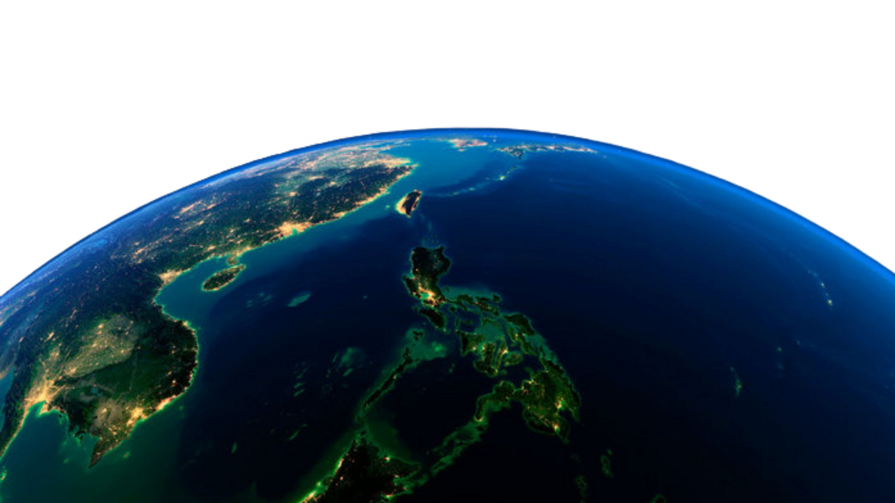
A PRESENTATION BY PROJECT GAIA
Climate Change in the Philippines through the Years

Slide 2





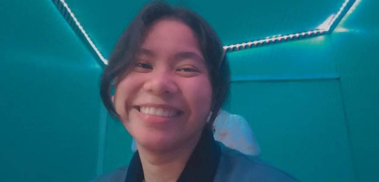

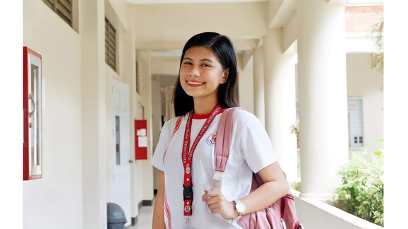
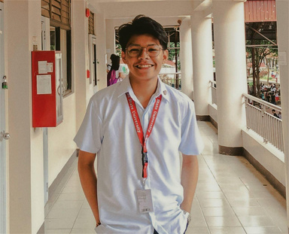
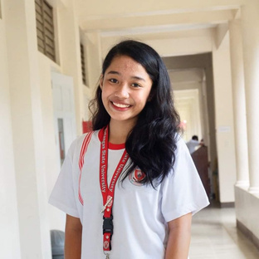
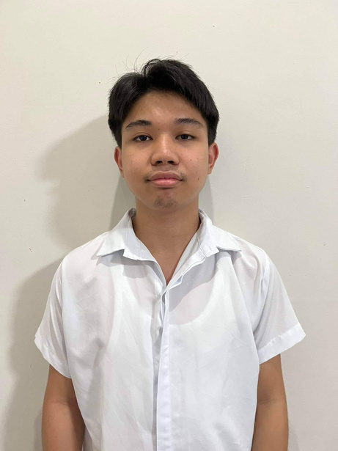



ELEDA, LOUISSE LAINE
JAVIER, MARJORIE
OCAMPO, EDBERT
SALAPARE, KIAN FRANCIS
TATLONGHARI, ANA KARL
MEET OUR TEAM MEMBERS

Slide 3

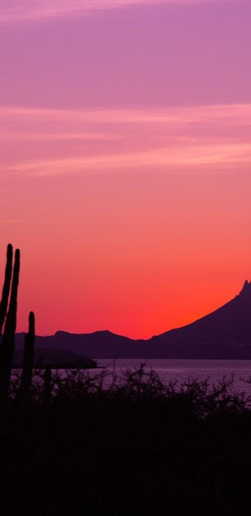

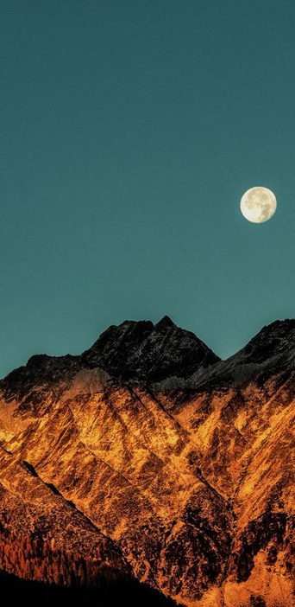



02
DISCUSSION
01
INTRODUCTION
03
SOLUTIONS

Slide 4

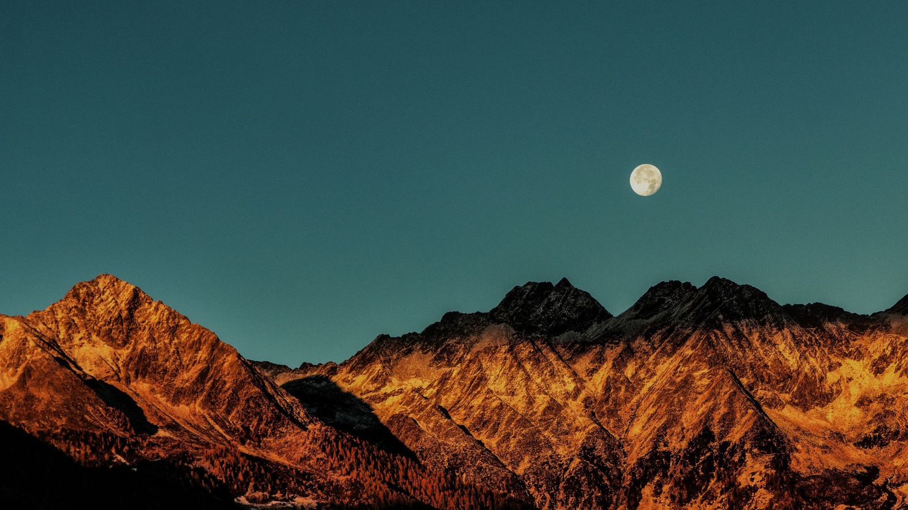


01
INTRODUCTION

Slide 5

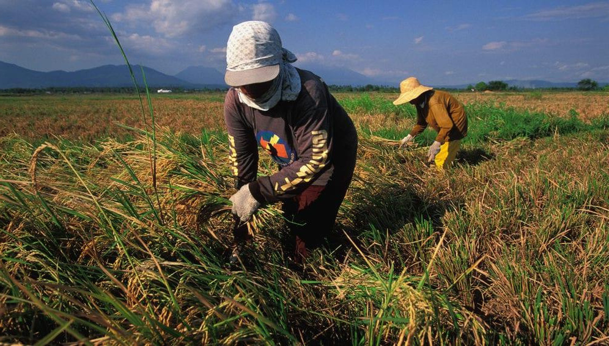

Let’s meet Mang Tonyo and Mang Samuel!
Mang Tonyo and Mang Samuel are both rice farmers from the province, while planting rice they talk about how way back in the old time the temperature during the dry season is not that hot but now they notice that as years pass by when the dry season is coming, their income deflates because the heat makes their field dry. They were both so worried about what will happen in the next years that will come if the temperature keeps on rising.

Slide 6

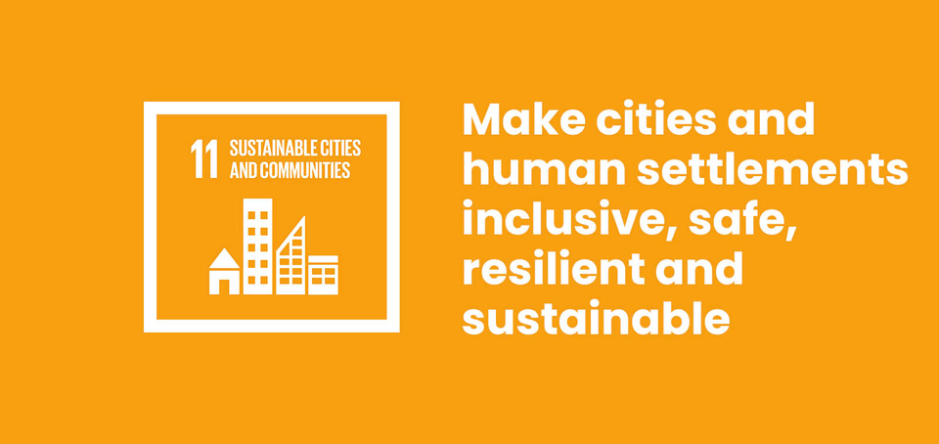


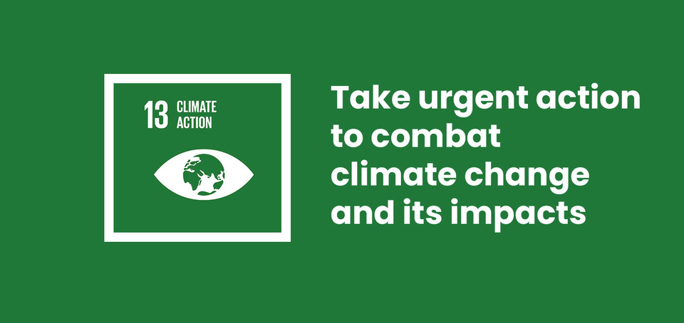
OBJECTIVES
To examine the past climate data in the Philippines
To advocate for Filipino people to take climate action for a more sustainable country

Slide 7

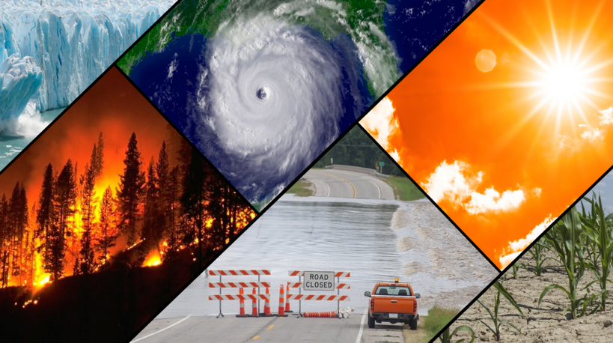
PROBLEM STATEMENT
Climate Change is already taking place!

Slide 8
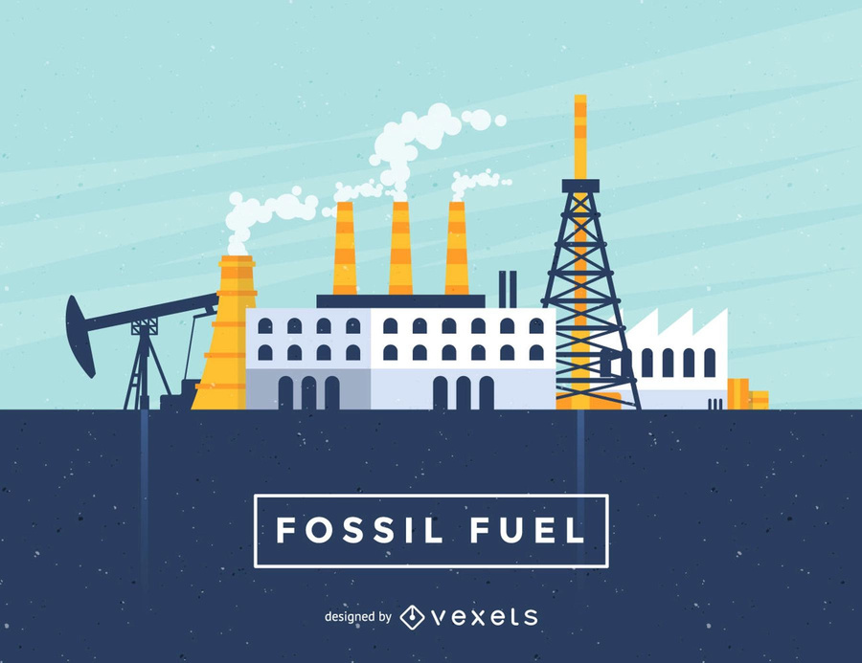
PROBLEM STATEMENT
Human actions are most likely to blame.

Slide 9
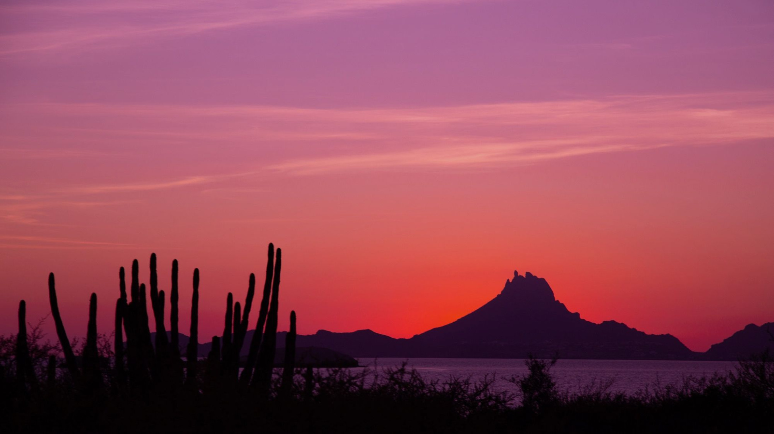
02
DISCUSSION

Slide 10
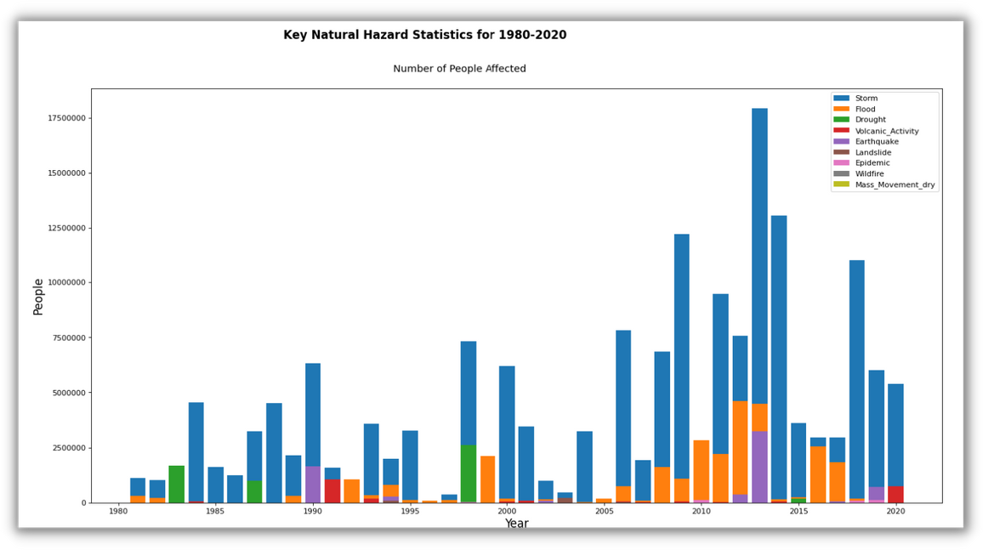

Slide 11
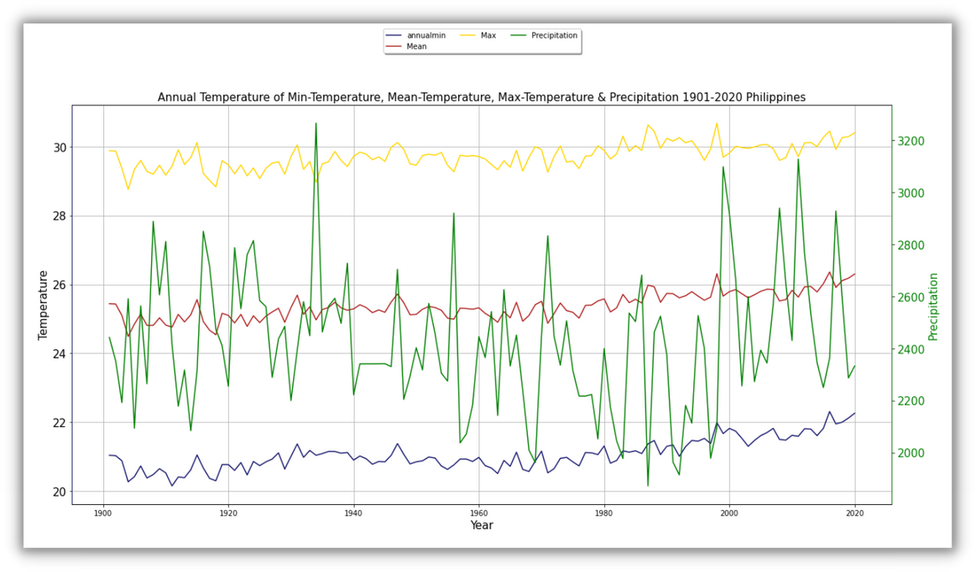

Slide 12
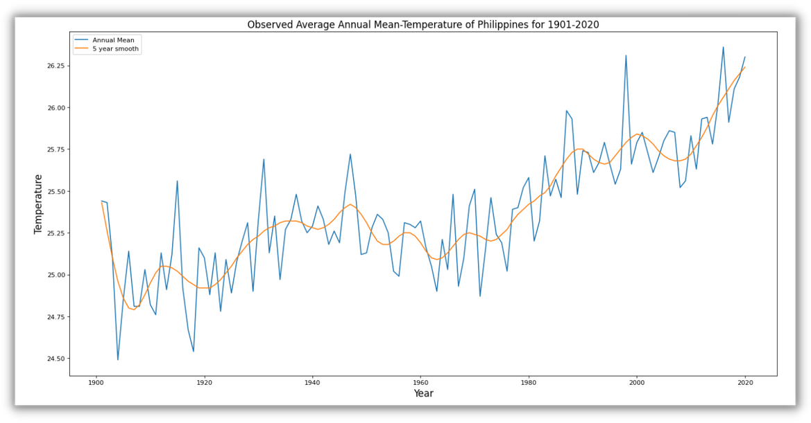

Slide 13

03
SOLUTIONS

Slide 14

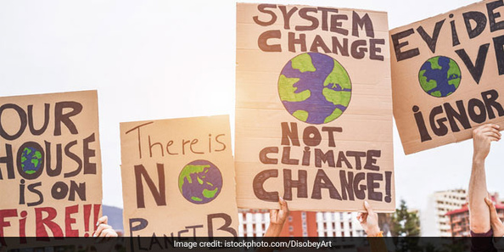

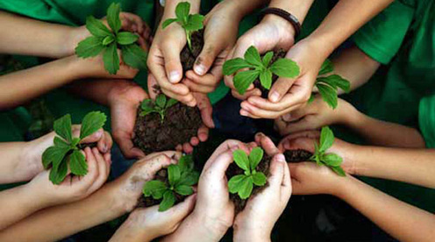

AWARENESS
ADVOCATE
ADAPT

Slide 15



“We can't save the world by playing by the rules, because the rules have to be changed.
Everything needs to change - and it has to start today."
-GRETA THUMBERG
Thank You

